Slide 1
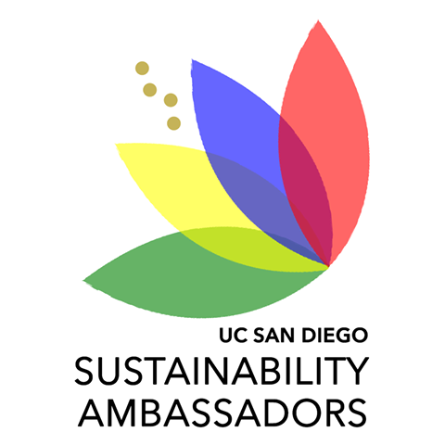
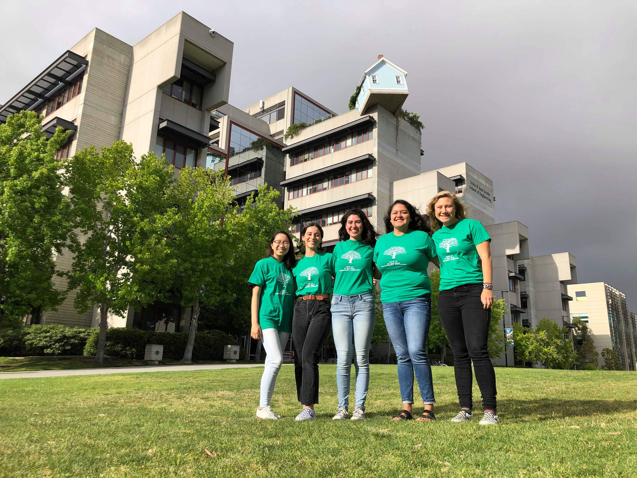
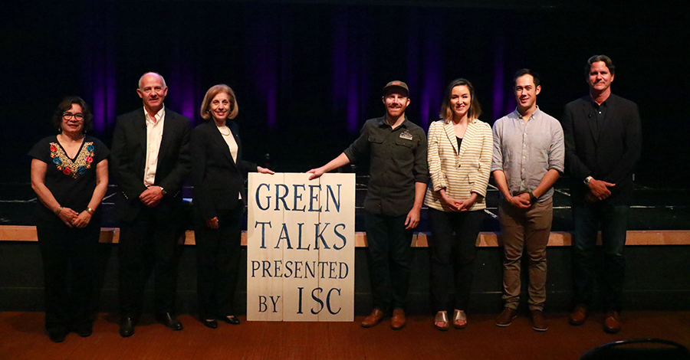
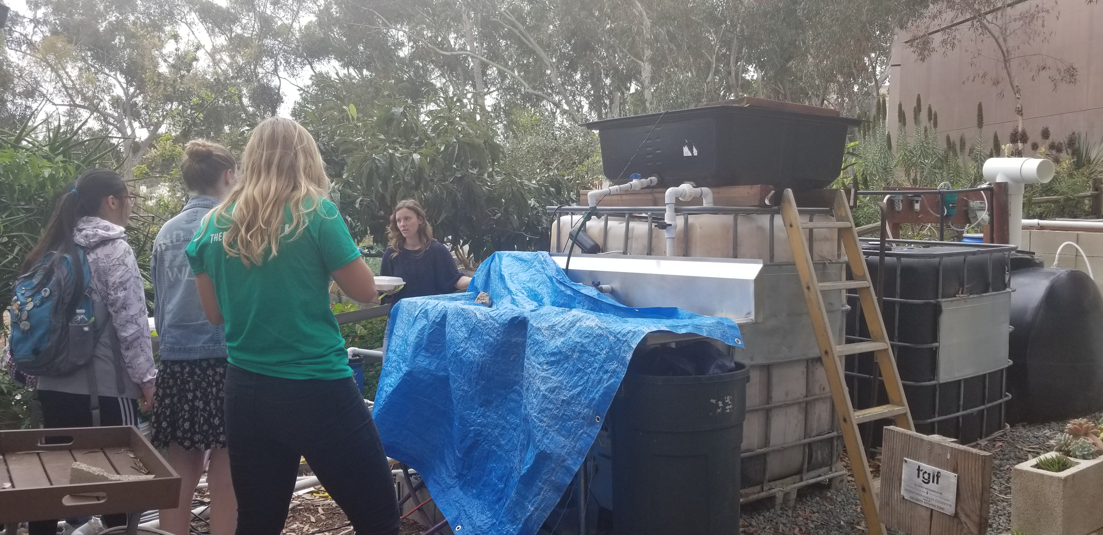
Sustainability Ambassadors Program
Carmen Lopez
University of California Carbon Neutrality Initiative Fellowship
Introduction
Project Goals
Green Talks 2019
The Sustainability Ambassadors Program consists of nine UC San Diego Students who educate others about what the carbon neutrality initiative is as well as ways that people can become more involved to help the UC system, and specifically UC San Diego, reach its carbon neutrality goals through in-class presentations, tabling, and the Cool Campus Challenge.
Carbon Neutrality Education:
Educate the sustainability ambassadors on the carbon neutrality initiative as well as other sustainability initiatives at UC San Diego and the City of San Diego.
Presentation and Events:
Engage students, staff, and faculty on campus about the carbon neutrality initiative and ways to be more sustainable with in-class presentations, tabling, and other events such as Green Talks.
Communication and Leadership Training:
Work with the ambassadors during winter quarter to prepare a student oriented presentation on the carbon neutrality initiative that is engaging as well as informative while also learning useful presentation skills.
Green Talks is a Ted-Talk style event that hosts seven speakers from the San Diego area to talk about their experiences and projects relating to sustainability. The speakers included co-founder of Chicano Park Josephine Talamantez, Lead Quality Analyst of AleSmith Brewery Peter Cronin, City Council District 1 Representative Barbara Bry, and many more.
Green Talks was a success with over 120 students, staff, and faculty attending the event. Attendees got to enjoy an art contest, raffle prizes, free food, a panel discussion, and networking with the speakers after the event.
Student Engagement
Program Framework
During winter and spring quarter, the sustainability ambassadors did many events to engage students with the carbon neutrality initiative
Cool Campus Challenge:
The ambassadors promoted the Cool Campus Challenge through presentations in order to teach students about how to take more sustainable actions in their daily lives.
SustainabiliTEA:
At this tabling event over 150 attendees were taught about the carbon neutrality initiative goals for the UC system.
USP 100:
Ambassadors presented to an Introduction to Urban Planning class about the carbon neutrality initiative.
USP 171: Dr. Hinds:
The ambassadors presented to a Sustainable Development class about the carbon neutrality initiative.
Rest and Digest:
Rest and Digest was an event where CNI Research Fellow Enid Partika taught students about her anaerobic digester and sustainability ambassador Ala explained its connection to the carbon neutrality initiative.
Green Talks:
Seven speakers were hosted to speak about their experiences and projects related to sustainability.
Sustainability Art Contest:
-Earth Plaza Palooza
-Sustainability Global Forum
Scripps Safety Day:
At this tabling event attendees were taught about the carbon neutrality initiative.
Carbon Neutrality Education (Fall):
In the fall, the ambassadors were taught by sustainability experts, such as the Vice Chancellor for Resource Management and Planning, to learn about the carbon neutrality initiative and the different sustainability initiatives in UC San Diego as well as the city of San Diego.
Presentation Preparation (Winter):
During Winter quarter, the ambassadors synthesized what they learned from the sustainability experts in the fall to create a student oriented presentation on carbon neutrality.
Student Engagement (Spring):
During the spring quarter, ambassadors began presentations, tabling, and hosting events such as Green Talks, as well as promoting the Cool Campus Challenge in order to engage students, staff, and faculty on campus about the carbon neutrality initiative.
Conclusions and Beyond
The Sustainability Ambassador was successful in reaching out to students about the carbon neutrality initiative as well as planning and hosting Green Talks. While it was helpful at times to have nine ambassadors to delegate tasks to, it could also be overwhelming and difficult to keep in contact with every ambassador and have people stay engaged. It was also difficult to know if people who were taught about the carbon neutrality initiative retained the information.
Acknowledgements
Sustainability Ambassad:ors
Jake McKinley, Camila Lautz, Nichole Yee, Ala Najduch, Vianey Valdez, Karen Thai, Alex Christodoulou, Riya Sony, Carl Whitesel
Sustainability Department UCSD:
Jennifer Bowser
Green Talks Committee:
Katie Oberman
Sustainability Experts:
Jane Teranes, Ashley Rosia, Byron Washom, Walt Kanzler, Michelle Perez, VC Gary Matthews, Dave Weil, Enid Partika, Albert Gasser
University of California San Diego
Notes:
Phase II: In-depth assessment (similar to LEEDS) and information exchange with entire research group. Inform staff of support services, shared equipment, onservation impact, altered techniques or materials. Inquire: needs and concerns
Phase III: Follow up

